Slide 1

Cricket uncovered
Prepared by:
Aum Vashi (2203396160383)
Kirtan Chauhan (2203396160047)
Preet Desai (2203396160060)
Hari Chauhan (2203396160046)
PIET-DS (CE)

Slide 2
Outlines
Abstract
Introduction
Problem Statement
Advantages
Disadvantages
Tools/ Technology
Future Scope
Conclusion

Slide 3
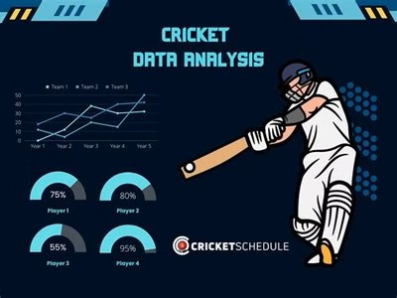
Abstract
The purpose of this project is to analyze cricket data and identify top performers in various roles.
Outcome of this project is a comprehensive Power Bi dashboard showcasing key players and the best 11 players of the tournament.

Slide 4
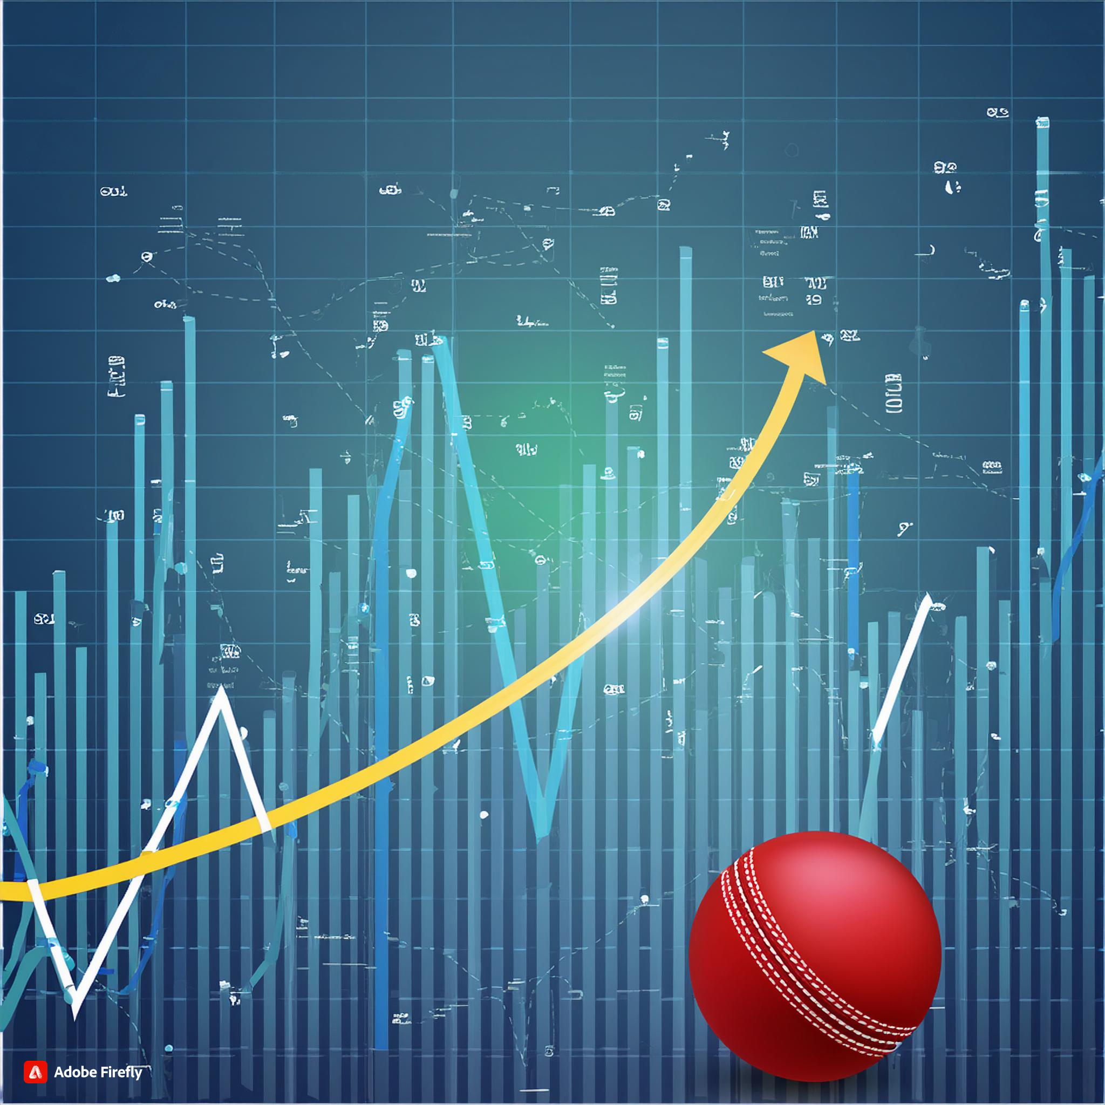
Introduction
Specific focus on cricket and the roles of players (opener, middle-order, all-rounder, finisher, bowler).
Objective :
To leverage data to make informed decisions on player performance and team composition. Need for an automated and visually intuitive solution to assess player performance.

Slide 5

Problem Statement
Difficulty in manually analyzing large volumes of cricket data to identify top performers.

Slide 6

Advantages
Data-Driven Decisions: Improved accuracy in identifying top performers.
Time Efficiency: Automated analysis saves time compared to manual methods.
Comprehensive Insights: Detailed visualization of player performance across various roles.
Enhanced Strategy: Better team composition and strategy formulation based on data insights.

Slide 7

Disadvantages
Data Quality Dependence:
Accuracy of analysis is highly dependent on the quality and completeness of data.
Initial Setup Time:
Time-consuming to set up the dashboard and ensure data accuracy.
Potential Bias:
Depending on the metrics used, there might be inherent biases in player evaluation.

Slide 8




Tools & Technology
Python
Html
Css
Power Bi
DAX

Slide 9
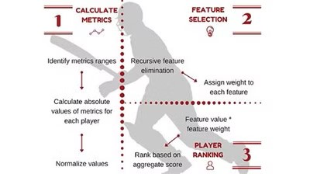
Future Scope
Advanced Analytics: Incorporate predictive analytics to forecast player performance.
Expanded Metrics: Include additional performance metrics such as fielding stats, fitness levels, etc.
Real-Time Analysis: Implement real-time data updates for live match analysis.
User Customization: Allow users to customize the dashboard based on specific requirements or preferences.
Integration with Other Sports: Extend the methodology to analyze data from other sports.

Slide 10

Conclusion
Emphasis on the value of data analysis in improving sports strategies and player evaluation.
Future potential of the project to evolve and incorporate more sophisticated analytics.
Encouragement to adopt data-driven approaches in sports for better performance and outcomes.

Slide 11
Thank You

